Slide 1


Validity
Dr Oliver Clark

Slide 2
This Week
Predictive and Concurrent Validity
Range Restriction
Construct Validity

Slide 3
This Video
Types of Validity
Establishing Predictive and Concurrent Validity
Relationship between reliability and validity

Slide 4
Face and Content Validation
Do the items assess what they claim to assess?
Are there items that represent all different areas of the construct?

Slide 5

Criterion Validity
Predictive
Concurrent

Slide 6
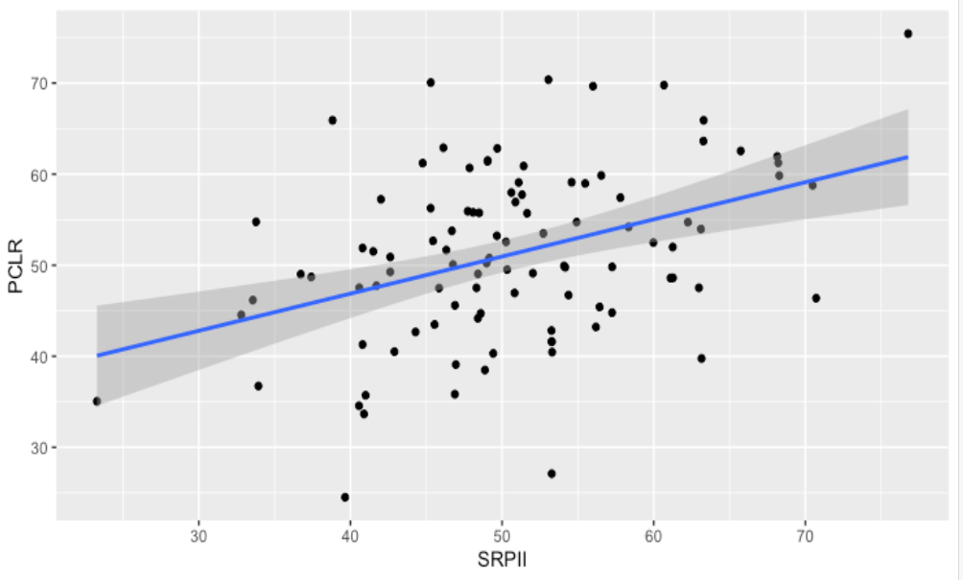
Validity

Slide 7
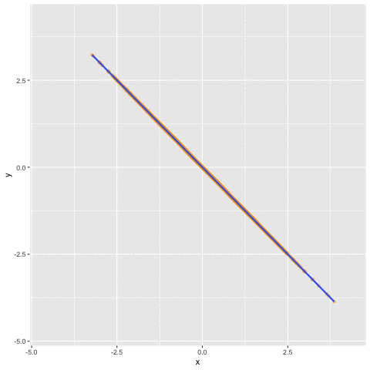
Validity

Slide 8


Relationship between Reliability and Validity
$$r_{xymax}\sqrt{r_{xx}×r_{yy}}$$
$$r_{xymax}\sqrt{0.87×0.79}=0.83$$

Slide 9
Scattergrams

Slide 10
Twisted Pear
r = 0.21

Slide 11
Anscombe’s Quartet (1973)
r = 0.816

Slide 12
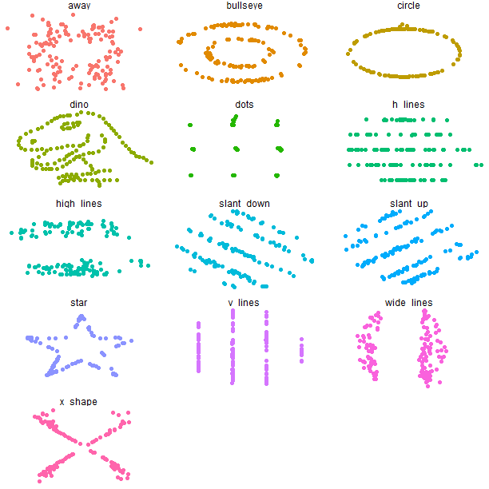
datasauRus dozen
{Steph Locke and Lucy D'Agostino McGowan

Slide 13
Range Restriction
r = 0.69

Slide 14
Range Restriction
r = 0.38

Slide 15
Range Restriction
r = 0.18

Slide 16
Range Restriction
N = 1637, p = 2.2e-16
N = 10000, p < 2.2e-16
N = 249, p = 0.005

Slide 17
Validity

